Slide 1
EE4530 – Lecture 1
Power Flow
Question 1:
In load flow studies of a power system, a generator bus is specified by,
  Real power and reactive power
  Reactive power and voltage magnitude
  Voltage and voltage phase angle
  Real power and voltage magnitude

Slide 2
EE4530 – Lecture 2
Power Flow
Question 2:
Gauss iteration has a faster convergence rate than Gauss-Seidel iteration.
  True
  False

Slide 3
EE4530 – Lecture 3
Power Flow
Question 3:
In a load flow study, a PV bus is treated as a PQ bus when
  Voltage limit is violated
  Active power limit is violated
  Phase angle is high
  Reactive power limit is violated

Slide 4
EE4530 – Lecture 4
Power Flow
Question 4:
Gauss Seidel iteration has a faster convergence rate than Newton Raphson method
  True
  False

Slide 5
EE4530 – Lecture 5
Active Power and Frequency Control
Question 5:
The load frequency control loop is to control the
  Active power and reactive power
  Reactive power and voltage
  Active power and frequency
  Voltage and frequency

Slide 6
EE4530 – Lecture 6
Active Power and Frequency Control
Question 6:
When there is a sudden load increase in the system, the steady-state system frequency is expected to
  Remain unchanged
  Increase
  Decrease
  None of the above

Slide 7
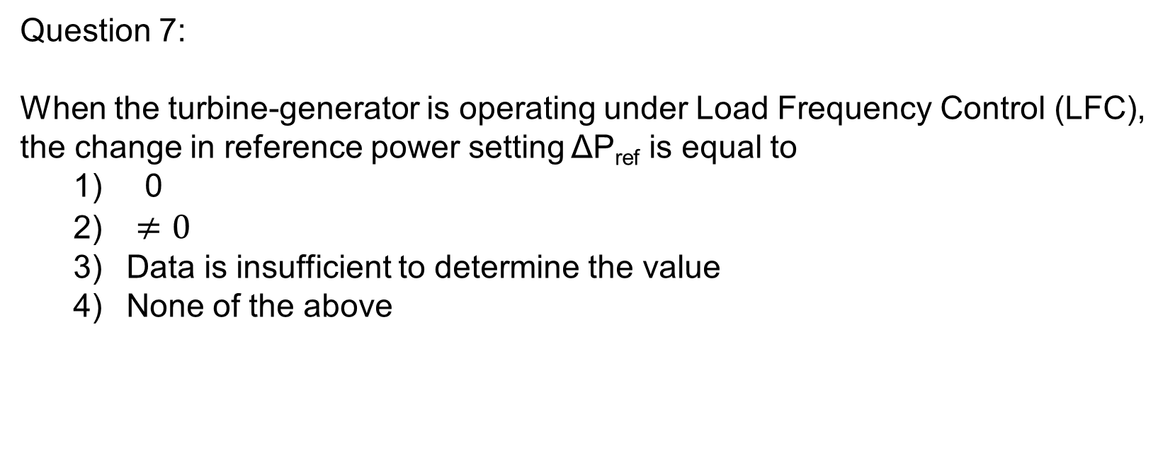
EE4530 – Lecture 7
Active Power and Frequency Control
Question 7:
When the turbine-generator is operating under Load Frequency Control (LFC), the change in reference power setting ΔP_{ref} is equal to
  0
  $≠0$
  Data is insufficient to determine the value
  None of the above

Slide 8
EE4530 – Lecture 8
Economic Dispatch
Question 8:
Economic dispatch states that “all generating units operate at equal incremental cost” under which operating condition?
  No system losses (lossless)
  Light load
  With system losses (with losses)
  Full load

Slide 9
EE4530 – Lecture 10
(Lecture 9 = Quiz)
Economic Dispatch
Question 10:
Generators under economic dispatch (lossless case) with violation in generation limits will have equal incremental cost.
  True
  False

Slide 10
EE4530 – Lecture 11
Economic Dispatch
Question 11:
For economic dispatch with losses, the optimum operation is achieved when
  All generators have equal incremental cost
  Product of the incremental cost times the penalty factor is the same for all generators
  All generators have equal penalty factor
  None of the above

Slide 11
EE4530 – Lecture 12
Economic Dispatch
Question 12:
Economic dispatch controller can achieve zero steady state frequency error and a fast dynamic response.
  True
  False

